Slide 1
Health Care Reform:
Opportunities & Challenges for Public Health
Oregon Public Health Association
Annual Meeting
October 10, 2011
Mike Bonetto
Health Policy Advisor
Governor John Kitzhaber

Slide 2
Agenda
  Future Leaders
  Federal & State Perspective
  Opportunities & Challenges for Public Health

Slide 3
I. Future Leaders

Slide 4
Telling You What You Already Know
Health care is in crisis
  We have the most advanced system in the world, but we have worse health outcomes
  We spend more on health care but have shorter live spans that most other industrial nations
  We buy care based on cost, and not on quality or value
The current system is unsustainable and heading rapidly towards collapse

Slide 5
What an Amazing Opportunity
Systems Thinkers
Collaborative Approach
Innovators
Challenge Status Quo

Slide 6
II. Federal & State Perspective

Slide 7
Goals of Federal Reform
From the beginning, the Obama Administration and Congressional leaders had two stated goals for health care reform:
    Provide universal health insurance coverage
    (or close to it)
    Slow the growth of health care costs
Both of these are laudable policy objectives.
The problem – they are difficult to reconcile
  Hard to slow cost growth when adding 32 million Americans
  to the insurance rolls with significant govt subsidies

Slide 8
Key Elements of Federal Reform
Guaranteed Issue – no pre-existing conditions
Essential health benefits that must be provided
Public subsidies and expansion of Medicaid
Adjusted community rating for individual and small groups
Individual responsibility mandate
Health insurance exchanges

Slide 9
Issues Not Being Addressed
Inefficiencies of the Existing System
  Regional Differences
  Non-adoption of “Best Practices”
Life-Style Issues Driving Consumption of Services
Preventative Healthcare

Slide 10
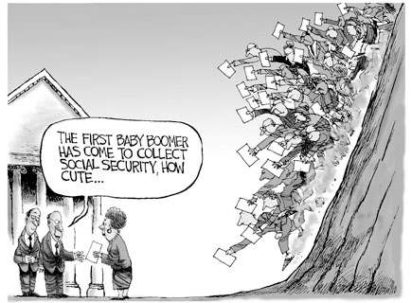
Notes:
9
We have a huge demographic shift occurring as the baby boomers age into Social Security and the Medicare system.
76 million people were born between 1948 and 1964.
The first boomers have hit Social Security already; it has been called the “silver Tsunami”
The boomers begin to hit Medicare in 2011.
And even though we know this shift is coming, we’re still afraid to talk about changes, as if talking about them are worse than ignoring them and letting the crisis occur.

Slide 11
Future of Medicare
2000 2025
Number of beneficiaries 39.5M 69.7M
Beneficiaries as share of pop. 13.8% 20.6%
2004 - Medicare accounted for 8% of all federal income taxes.
2015 – 19%
2025 - 32%
2075 – 90%
2024
Medicare Trust Fund assets are exhausted

Slide 12
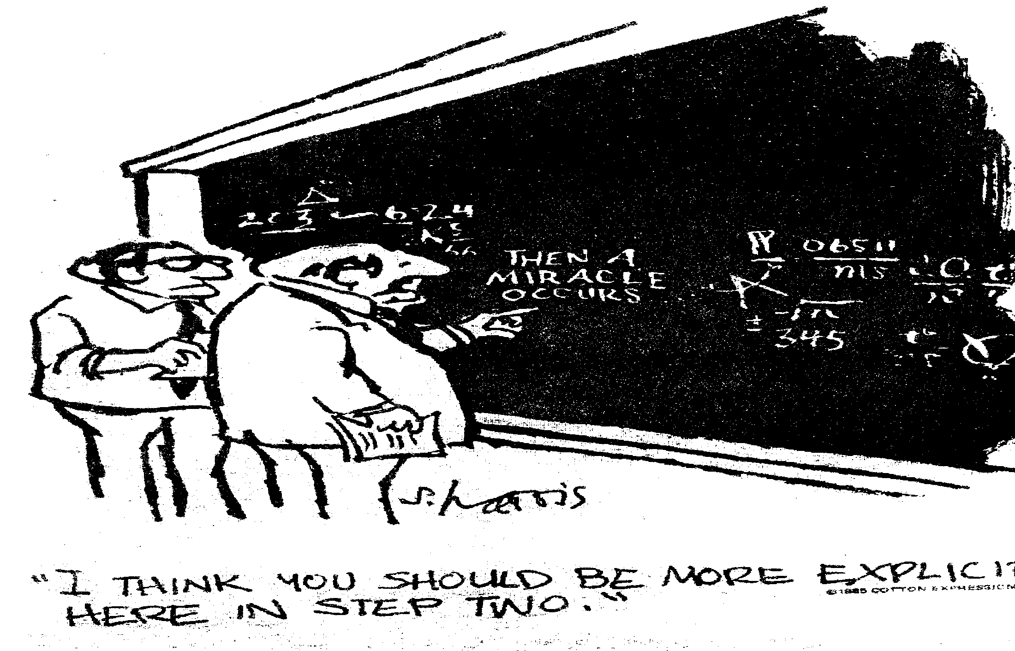
Notes:
11

Slide 13
Oregon’s Long Term Budget
Notes:
12

Slide 14
Vision of HB 3650
  Better coordination & integration of physical health, mental health, and oral health, elimination of fragmentation in system. Hospitals, providers of all kinds working together.
  Federal approval to pool Medicare and Medicaid health care funds for those who have health care paid for by both (“dual”) brings additional dollars into a new integrated system
  Coordination Care Organizations (CCOs) to manage to budgets fixed to growth in state revenue or some other standard
  CCOs will be accountable for and manage to metrics, outcomes and resource allocation
Notes:
13
13

Slide 15
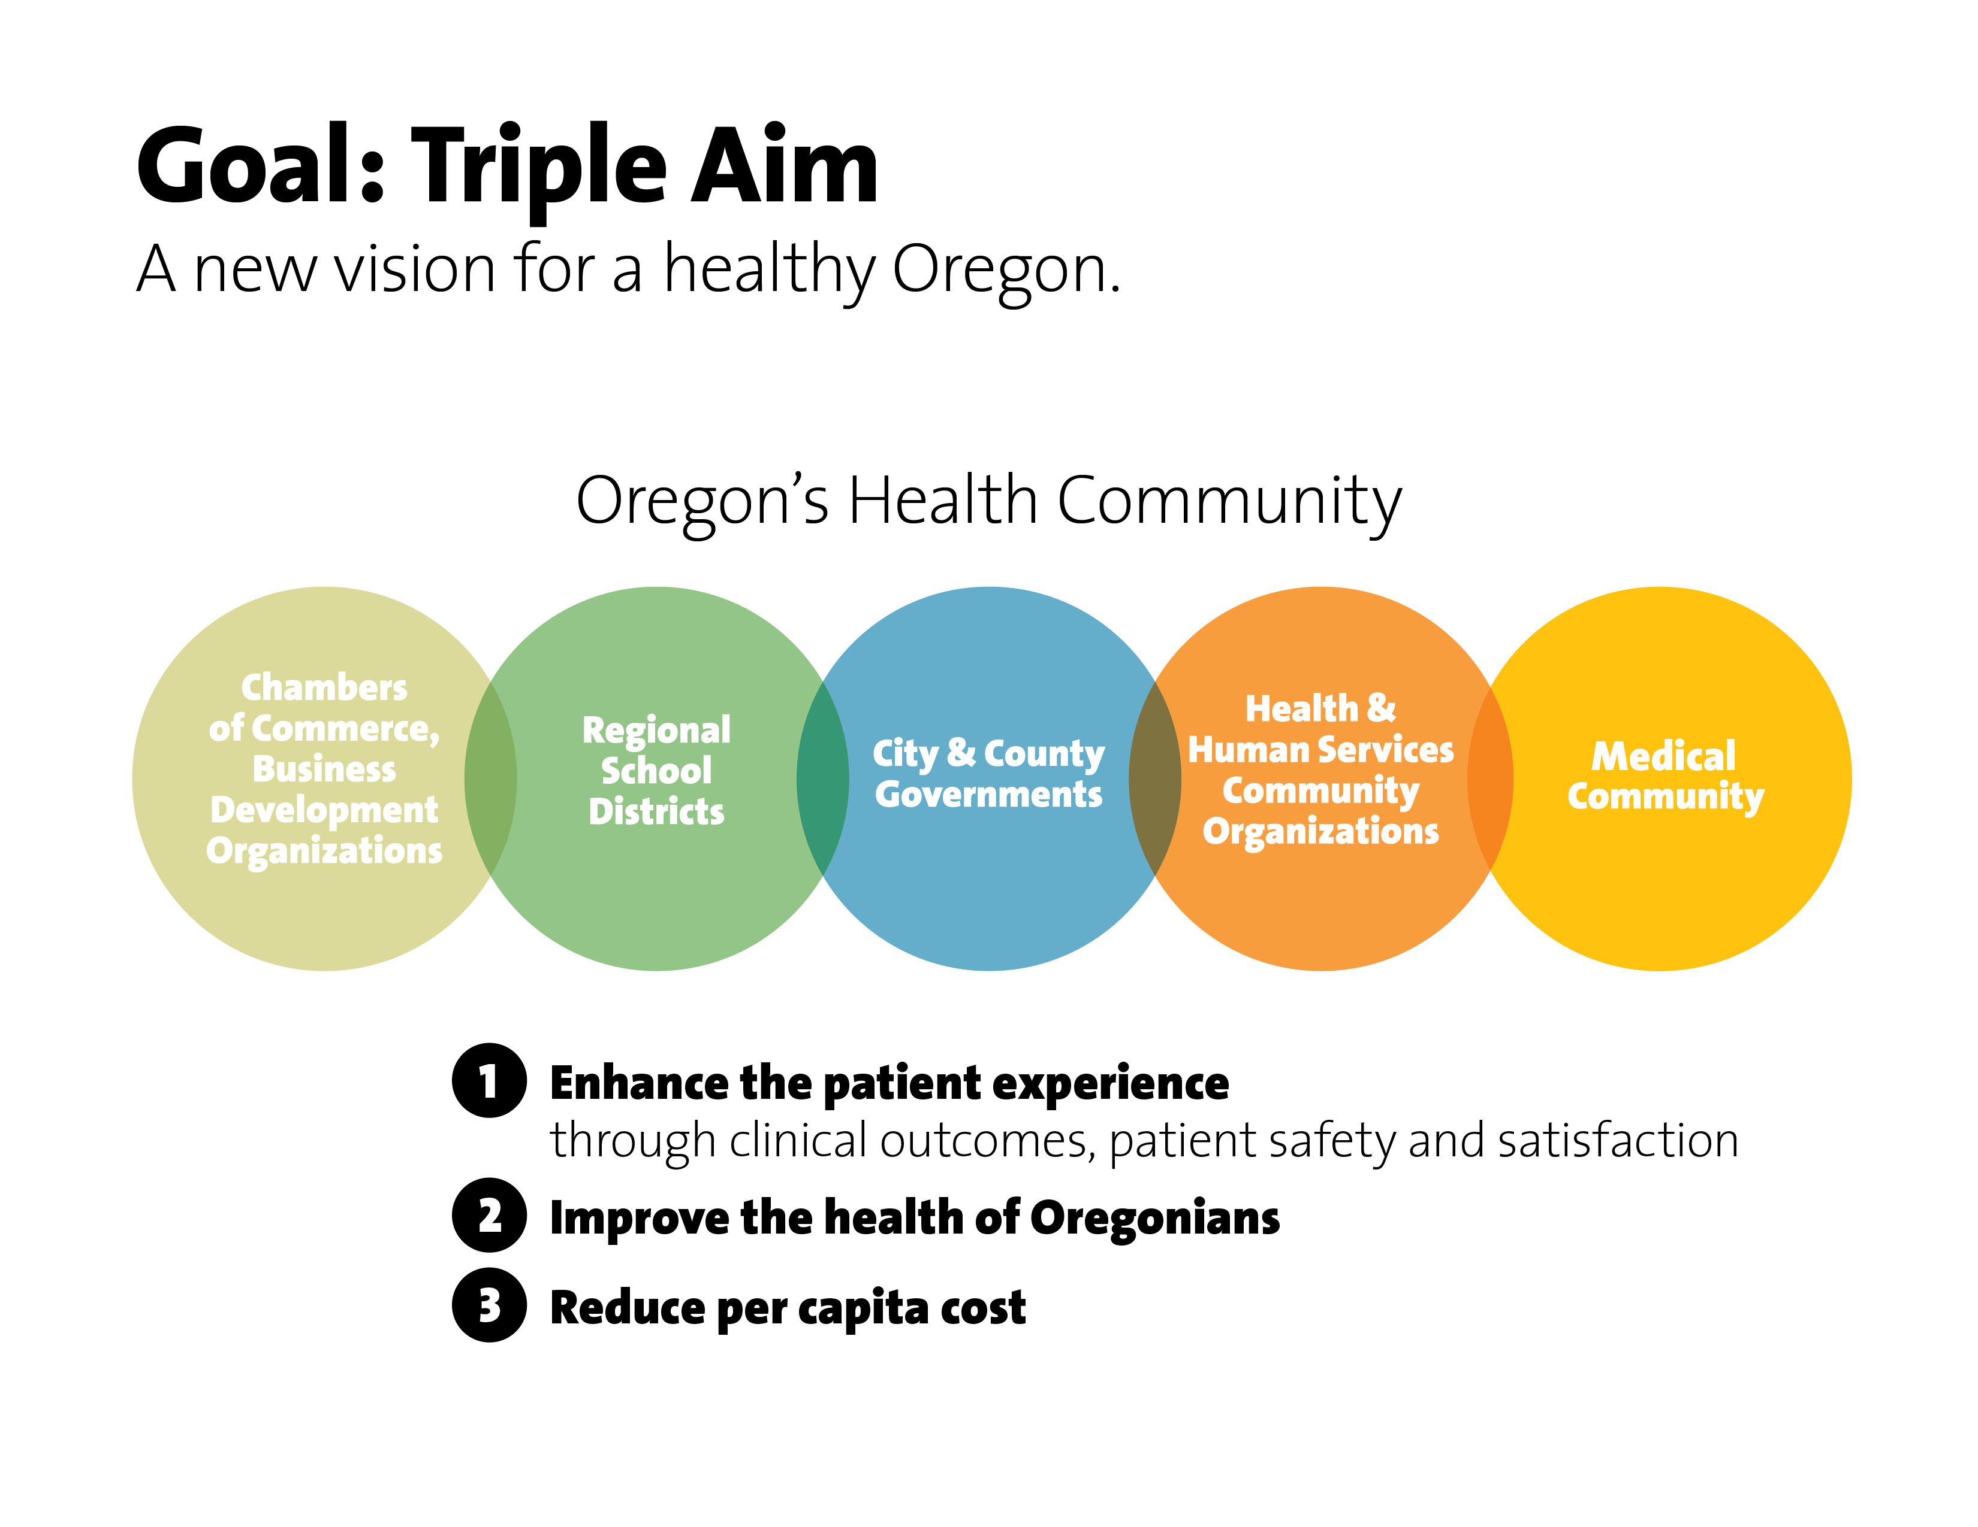

Slide 16
Concept
Integration and coordination of benefits and services
Local Accountability for health and resource allocation
Improved outcomes
Reduced costs
Healthier population
Redesigned Delivery System
Standards for safe and effective care
Fixed budget indexed to sustainable growth
Notes:
15
15

Slide 17
Coordinated Care Organizations
Locally run
Revenue flexibility to allow innovative approaches to prevention, team-based care, community health workers
Global budget & shared savings
Measurable outcomes
Accountability

Slide 18
What we can build on?
Mosaic Medical / Bend - 2010. One year-long pilot program with 100 costliest Medicaid patients. Frequent ED visits up to 25-30 year. Team based care. Cost decreased: Mosaic's 6,400 Medicaid patients in 2010 decreased by more than $621,000, thanks to just six months of reduced reliance on the emergency room for non-emergent care.
CareOreon Pilot Project – 41% of their Medicaid clients. Highest risk. Reduced inpatient hospitalization between 16 – 18%. ED stabilized during a period when other ED increased. Costs decreasing to non-high risk patients.

Slide 19
YEAR 2 SAVINGS
Savings based on:
  Ability to reduce preventable conditions
  Widespread use of primary care medical homes
  Improved outcomes due to enhanced care coordination and care delivered in most appropriate setting
  Reducing errors and waste
  Innovative payment strategies
  Use of best practices and centers of excellence
  Single point of accountability for achieving results
Notes:
18
18

Slide 20
YEAR 3+
Begin to use redesigned delivery system platform for other state contracts:
  PEBB
  OEBB
Redesigned delivery system could be core component of health insurance exchange and an opportunity for private sector to participate
Notes:
19
19

Slide 21
RISKS/CONCERNS
Reductions based on 09-11 spend and medical inflation is not figured in, thus making them steeper
Ability to make transformational system changes will be more difficult in context of rate reductions
Access to care could suffer – how can we mitigate
Will need federal approvals
If reductions are too steep, infrastructure will be lost
Need to guard against cost shift to private sector
Notes:
20
20

Slide 22
Timeline
Through Nov. 2011: Public input opportunities and information sharing
  4 Governor work groups
  Statewide presentations
Nov. 2011 – Update to Legislature
Dec. 2011: CCO plan implementation plan due to Legislature
Feb. 2012: Legislative Session
Mar. 2012: If approved, send CCO plan to CMS
Late Spring/Summer 2012: First CCO launches

Slide 23
III. Opportunities & Challenges for
Public Health

Slide 24
Public Health - Rip Van Winkle
Advice to a Modern-Day Rip Van Winkle: Changes in State and Local Public Health Practice During the MMWR Era at CDC
October 7, 2011 / 60(04);112-119
Melvin A Kohn, MD
David W Fleming, MD
“Imagine for a moment a dedicated but exhausted state or local public health practitioner nodding off while reading the volume 10, number 1, issue of MMWR in January of 1961, only to awaken, a la Rip Van Winkle, 50 years later..”

Slide 25
Public Health - Rip Van Winkle
(The Next 50 Years)
      The need to contain health-care costs could profoundly improve the linkage between health care and public health. Or not.
      2. The structure of our antiquated public health system will have changed, either because of us or despite us.
      3. Depending on how well we have addressed the current leading causes of preventable death and disability, government public health agencies will either be empowered or marginalized.

Slide 26
Changing Health Landscape
Over the next twenty years the US health care system will change itself. Those dimensions on the left will not disappear, but because of the trends above they will increasingly be modulated toward the right.
Today
Tomorrow
Acute treatment
Cost unaware
Professional prerogative
In-patient
Individual profession
Traditional practice
Information as record
Patient passivity
Chronic prevention & management
Price competitive
Consumer responsive
Ambulatory – Home & Community
Team
Evidence based practice
Information as tool
Consumer engagement and accountability
Successful health organizations will understand this transition and create strategies to respond.
Ed O’Neil, UCSF Center for Health Professions

Slide 27
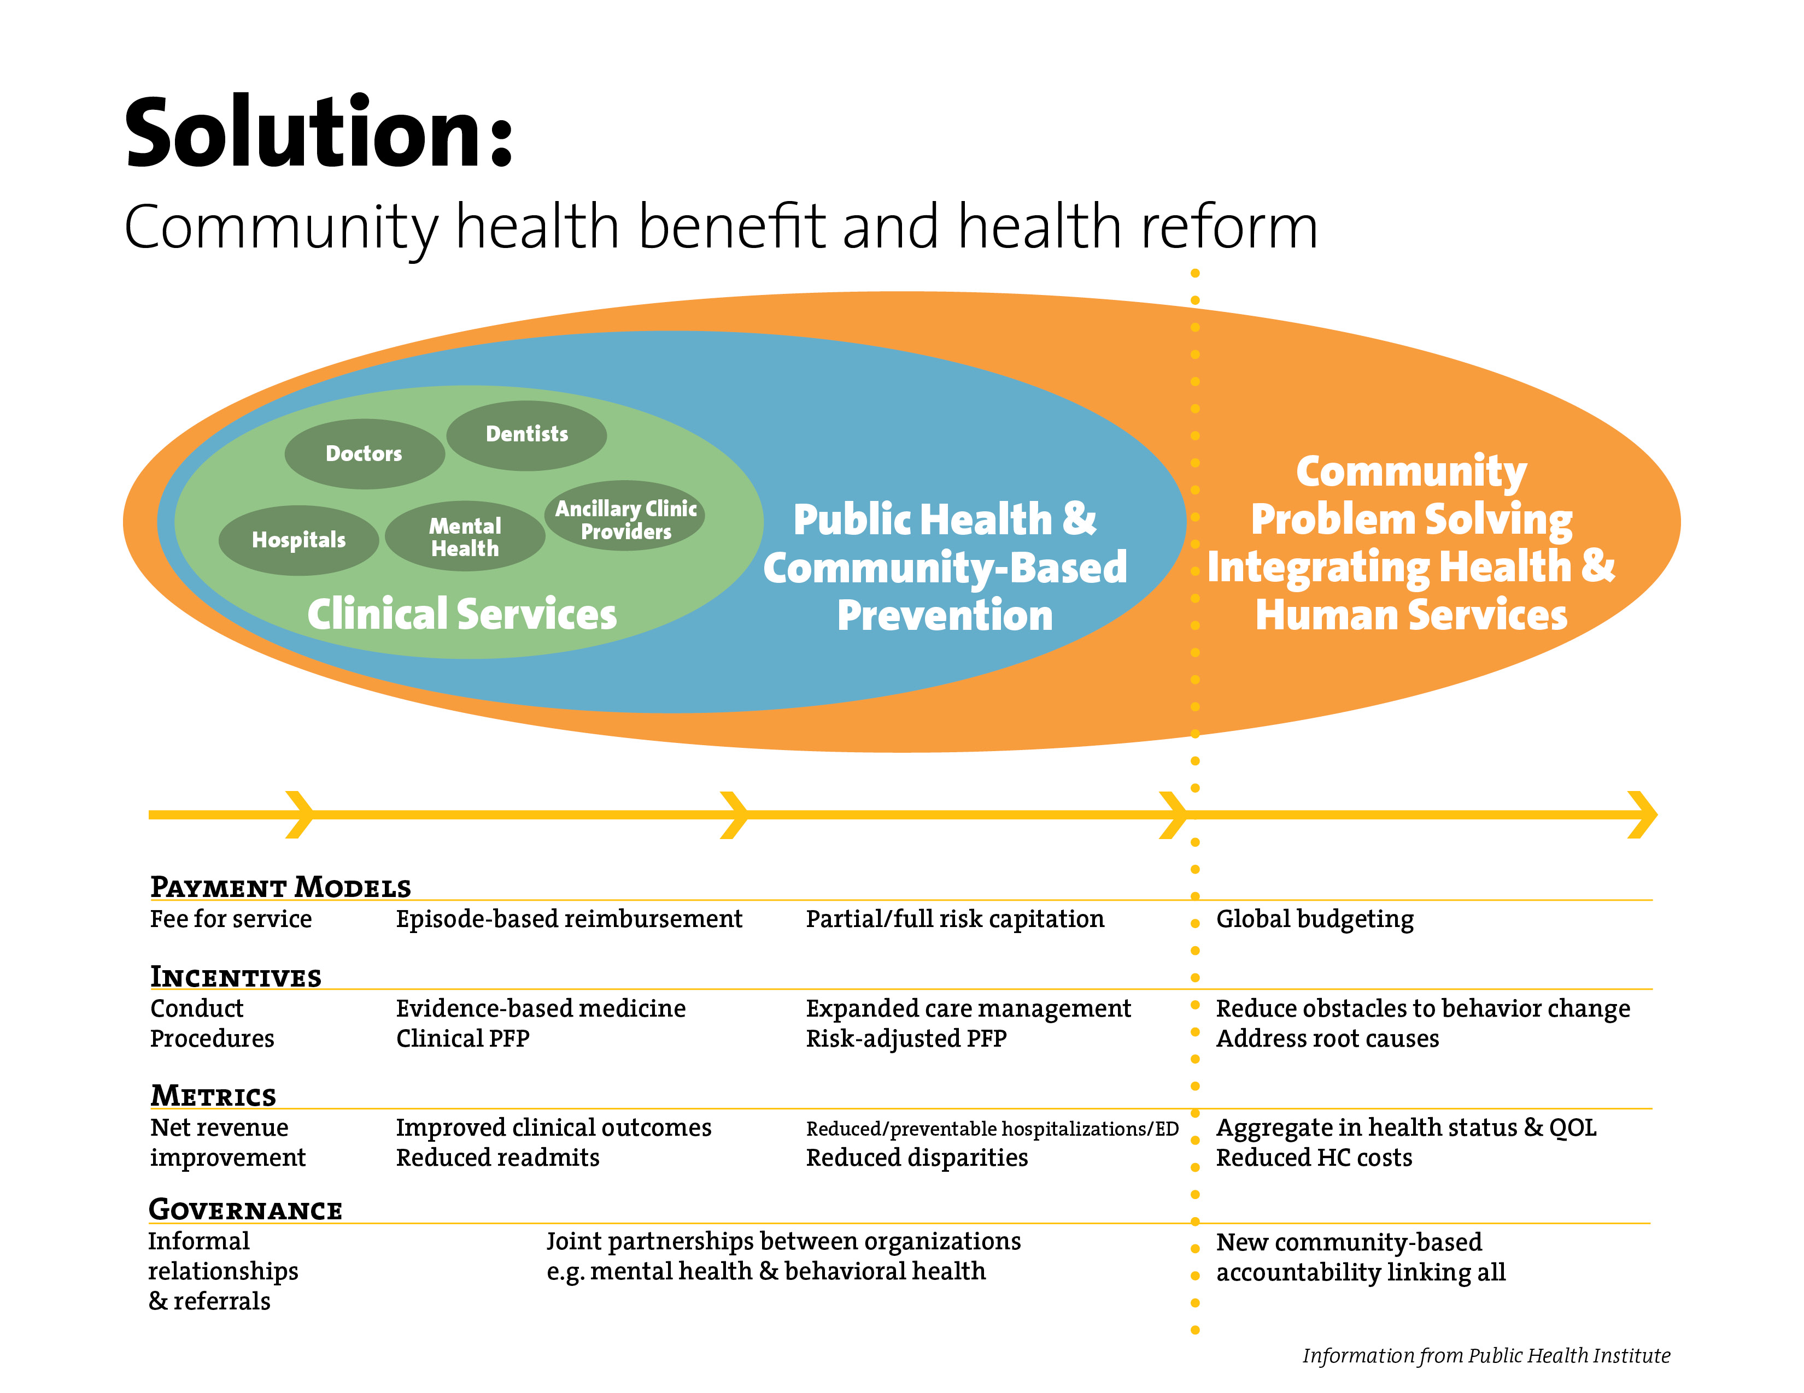

Slide 28
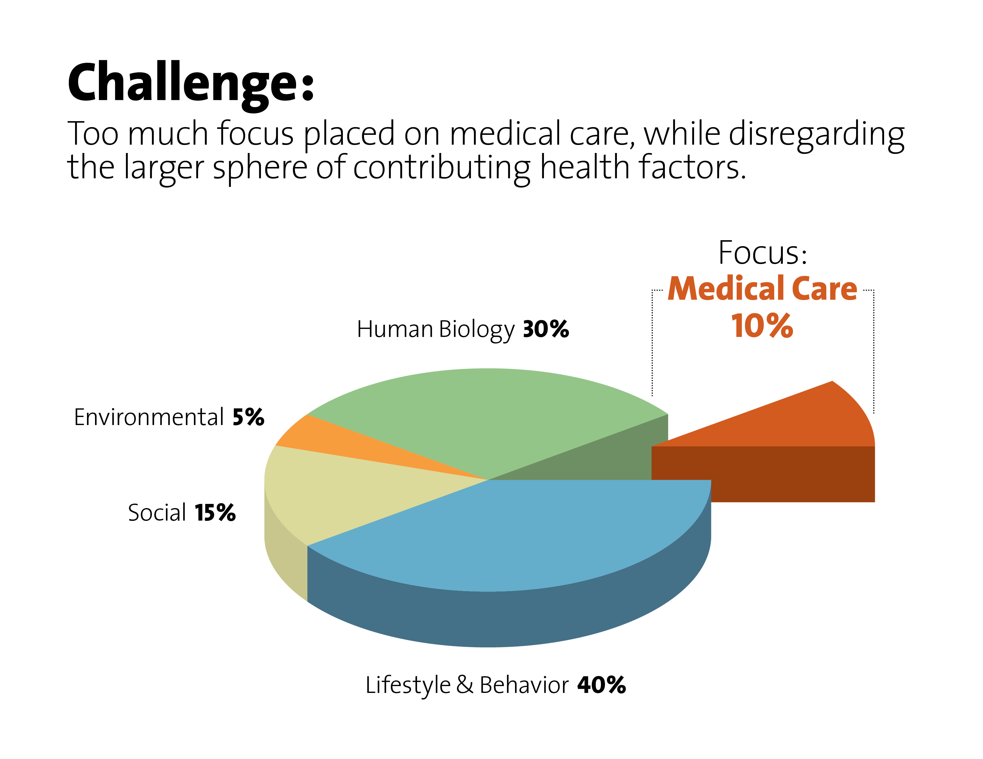

Slide 29
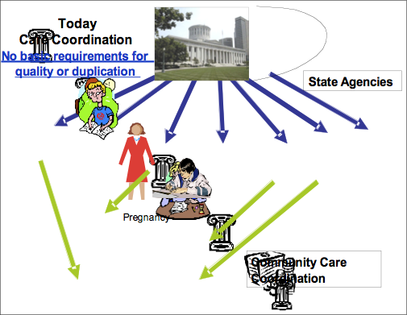
Today - Fragmentation and Duplication
Little, if any, coordination, integration and support of public health, medical care, and social services
Notes:
So once you’ve done the assessment and raised some money – what next? That’s when we can begin to realign community resources to achieve better outcomes.
I want to quickly walk you through an example that Dr. Mark Redding from Richland County, Ohio. He and his wife, Sarah, have done amazing work in this area – and have really led the nation.
Currently, care coordination funding goes to multiple state agencies resulting in multiple state and county programs and duplication of service. There are often no basic requirements for focusing on those most at risk. There are no basic measures for cost per person, efficiency or effective quality. One pregnant 17 year old in extreme poverty may have 12 care coordinators each representing a substantial monthly state expense and still not connect to care. The invoices are paid to the agencies based on the client being on a service list, phone calls made, notes charted and other deliverables that do not represent confirmed benefit to the individual served
The Community Health Integration of tomorrow works to align all care coordination agencies in the region towards a common mission of finding those at risk and connecting them to care. Duplication is not permitted.

Slide 30
Future - Collaboration & Coordination
Notes:
So once you’ve done the assessment and raised some money – what next? That’s when we can begin to realign community resources to achieve better outcomes.
I want to quickly walk you through an example that Dr. Mark Redding from Richland County, Ohio. He and his wife, Sarah, have done amazing work in this area – and have really led the nation.
Currently, care coordination funding goes to multiple state agencies resulting in multiple state and county programs and duplication of service. There are often no basic requirements for focusing on those most at risk. There are no basic measures for cost per person, efficiency or effective quality. One pregnant 17 year old in extreme poverty may have 12 care coordinators each representing a substantial monthly state expense and still not connect to care. The invoices are paid to the agencies based on the client being on a service list, phone calls made, notes charted and other deliverables that do not represent confirmed benefit to the individual served
The Community Health Integration of tomorrow works to align all care coordination agencies in the region towards a common mission of finding those at risk and connecting them to care. Duplication is not permitted.

Slide 31
A Community Health Collaborative Framework
Critical Activities
Reorganize Delivery
Reform
Outreach & enrollment
Medical home & coordinate care - ED diversion
Affordable Rx
Chronic disease management
Coverage of low-wage workers
Organize donated care
Prevention & wellness services
Assess health status, disparities, & effectiveness of services
Population based
Comprehensive
Integrated
Culturally competent
Evidence based
Public-private collaboration
Multi-disciplinary
Interoperable information systems
Assess & adapt
Positive health outcomes
Better health, for more people, at less cost
Notes:
30
When looking at successful collaboratives throughout the U.S., many begin their work with one, some, or all of the “8 critical activities.” This gives an opportunity to experience working differently, collaboratively. When communities have success with and experience the critical activities, trust, confidence, momentum builds. This momentum provides the platform for bolder more comprehensive reorganization. I cannot stress enough the importance of immediate success.

Slide 32

Employer
PROVISION OF THE
COMMON POOL
Wages
Insurance Premiums
Federal
Medicaid
Match
State Medicaid Funds
Federal
Medicare
Tax
Out-of-pocket
Common Pool Resources – Money for Health Care
Hospitals
Other Health
Professions
Medical
Equipment
Suppliers
Doctors
Pharmaceutical
Companies
Notes:
31

Slide 33
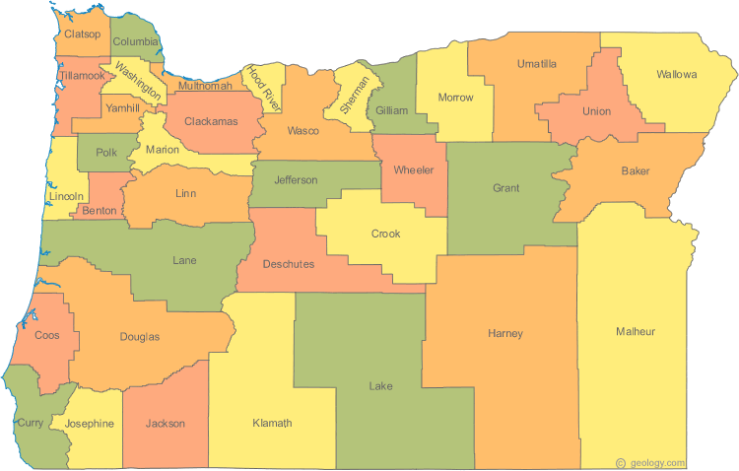
Public Health & Counties
Notes:
Lane County
Crook, Deschutes, Jefferson Counties
Jackson & Josephine Counties
Baker, Wallowa, Union Counties
Benton, Lincoln, and Linn Counties (parts of Marion & Polk)
Coos & Curry Counties
Clackamas, Multnomah, Washington Counties

Slide 34
Community Benefit -
Intent of IRS Definition
To encourage hospitals to play a role in efforts to improve health status and quality of life in local communities.
To move beyond charity care as the exclusive means to demonstrate commitment as a tax-exempt health care institution.
Expect a primary focus in communities with disproportionate unmet health needs.

Slide 35
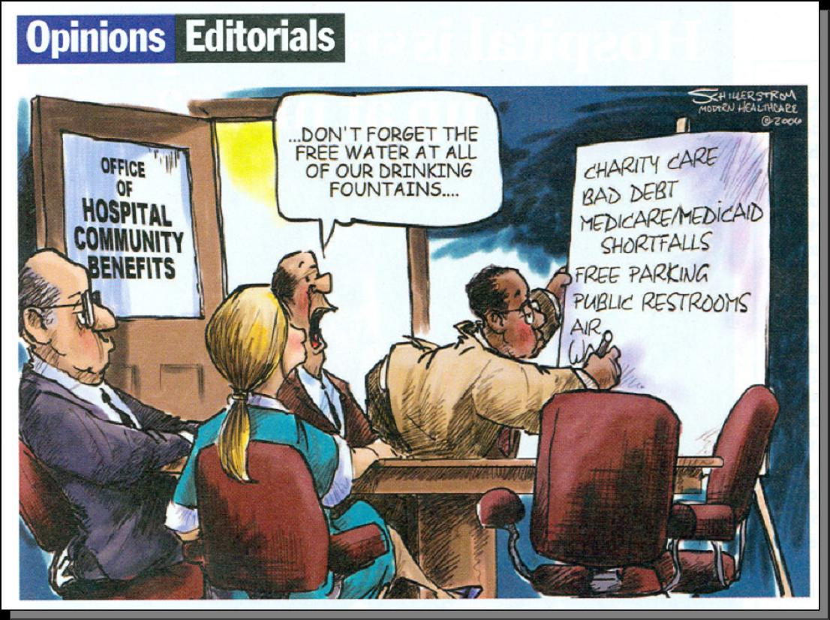
Community Benefit -
Trends in Practice
There are many
examples of
outstanding
programs in
hospitals across
the country, but
market dynamics
have influenced
the interpretation
of community
benefit.

Slide 36
Community Benefit -
Best Practice - Five Core Principles
Emphasis in communities with disproportionate unmet health needs
Emphasis on primary prevention
Build community capacity
Build a seamless continuum of care
Collaborative governance

Slide 37
Community Benefit -
Federal Health Reform
Charity care rolls dropping – How will NPHs fulfill their charitable obligations?

Slide 38
The Foundation for Success -
Health Equity and Health Information Technology
Health equity is the attainment of the highest level of health for all people.
Achieving health equity requires valuing everyone equally with focused and ongoing societal efforts to rectify historical and contemporary socially patterned injustices, and the elimination of health disparities
Public health engagement with development of health information exchange is important to improve our ability to monitor the health of the community.

Slide 39
Conclusion
  Public Health Students - Future Leaders
  Opportunities
      Fitting in to new model(s)
      New partnerships
      Focus on chronic disease
      Health IT
  Challenges
      Status Quo
      Decreasing revenue
      Health equity
      County-based system

Slide 40
Questions?

